Slide 1

A Data Structure for Customer Insights
Jim Porzak DSPT Meetup Lisbon, Portugal November 8, 2018

Slide 2

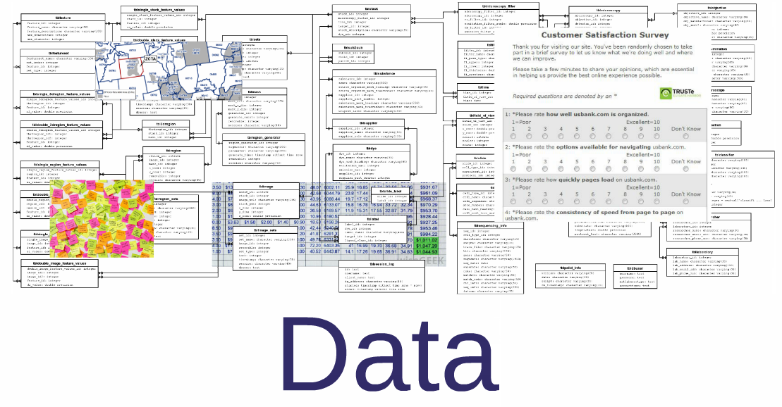

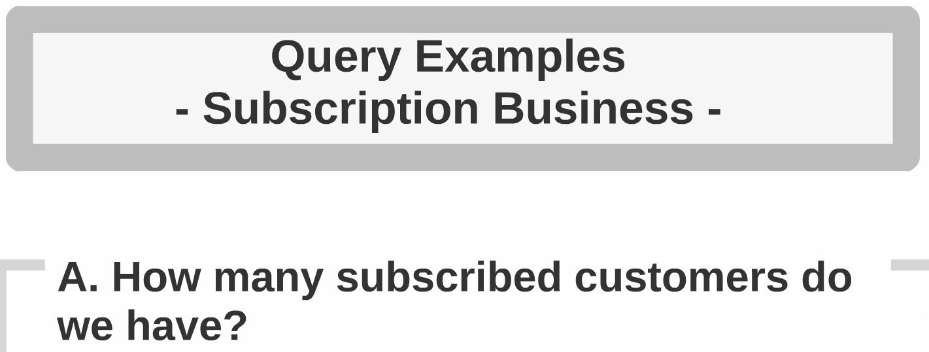
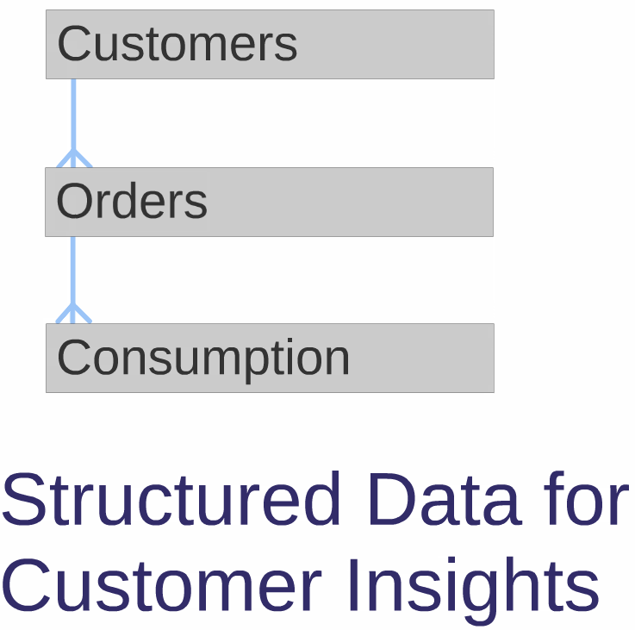


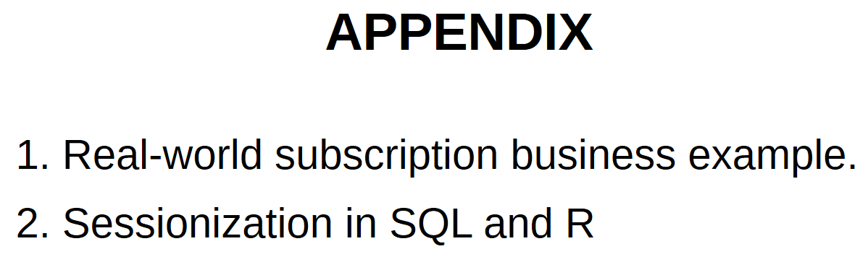
What We’ll Cover

Slide 3

Who Are They?
Anyone who gives you money; or
has ever given you money; or
should give you money.
Regardless of the nature of your organization!
Product sales
Subscription sales
Charity
???
Very broad!

Slide 4
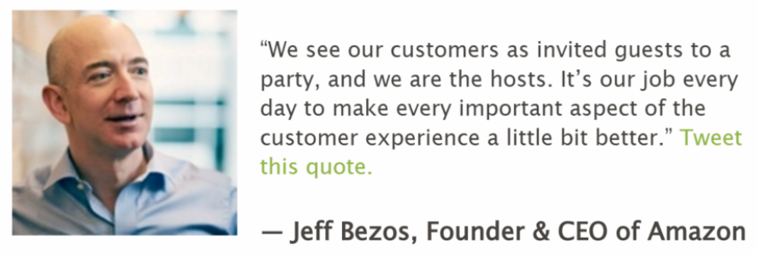
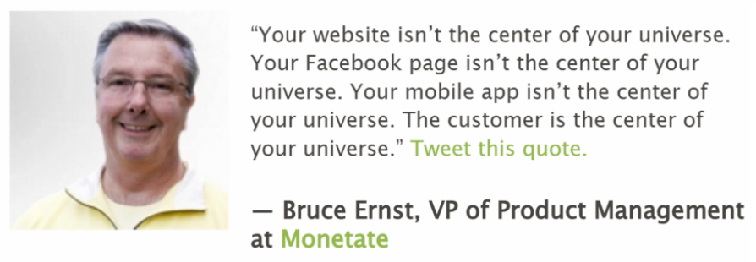
Why do we care?
Advice to Jim: “Take care of your customers and they will take care of you” – Tony Gault, 1983
Be Customer Focused!

Slide 5
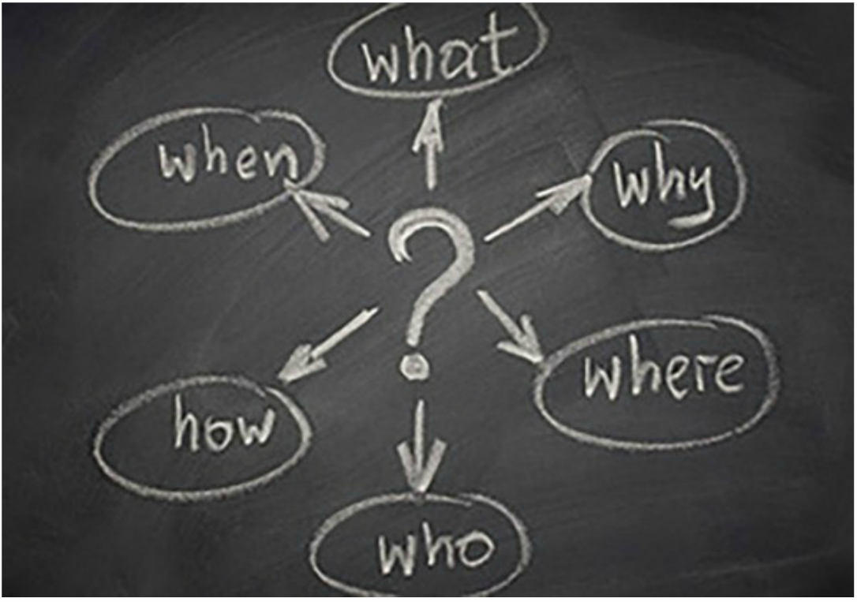
Take Care of Them!
To do so, we need to understand them.
Back to Journalism 101!
Five of these are
kind of easy.

Slide 6


The Big Customer Challenge
Why?

Slide 7
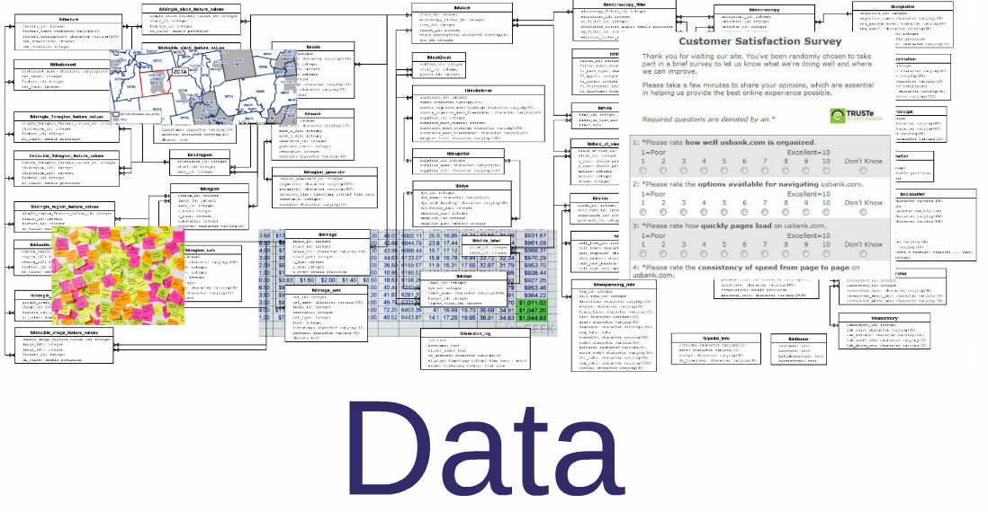
Customers Are Viewed Through…

Slide 8

Data Flavors
Operational Systems
Direct Responses
Order Processing
Fulfillment
Web site(s)
Call Centers (CRMs)
Email system(s)
Front line employee “systems”
Stated preferences
Search requests
Mindful clicks
Surveys: NPS, satisfaction, …
Social Comments
Customer ID!
Data Appends
Analytic Results
Neighborhood demographics
US Census @ ZIP5 or Census Block Group level
PRIZM, etc
Individual match-backs: Acxiom
Pooled industry data
From our data science team:
Segments
Scores
Recommendations
Updated in “real time” – relative to customer’s timescale.

Slide 9
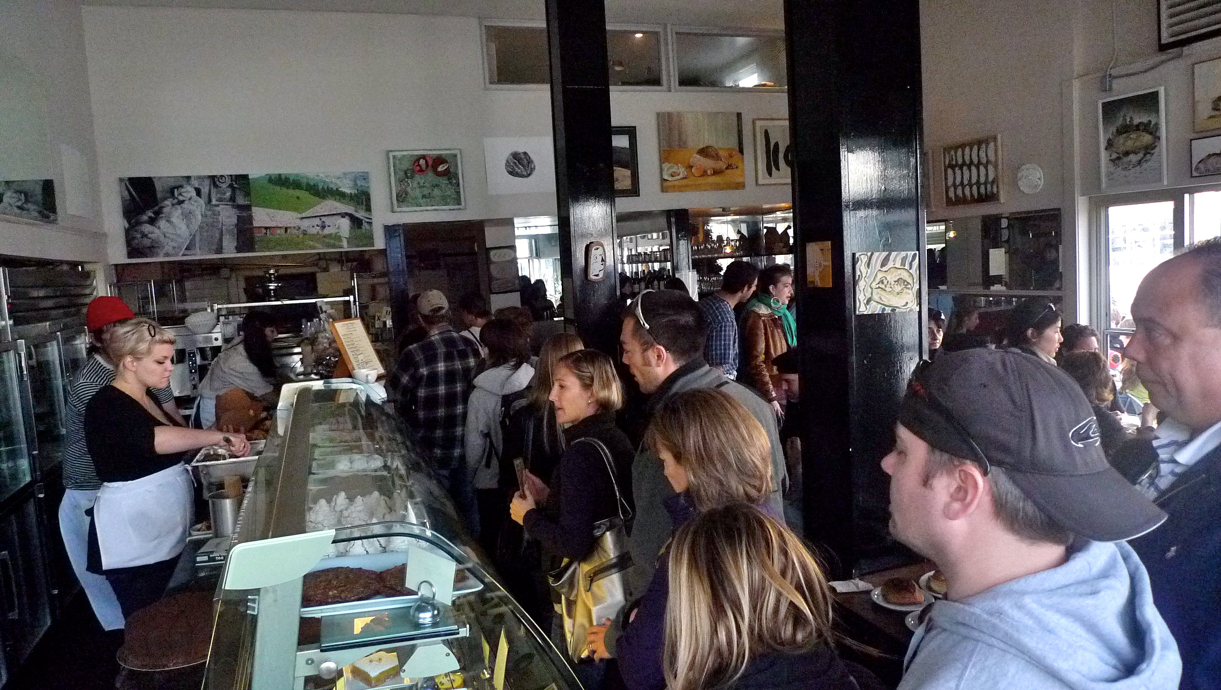
Op Sys are Problem Focused!
How do you sell bread?
You tell me what you want.
I give you the bread.
I tell you what it costs.
You give me the money.
Who? What? When? Where? Why?

Slide 10
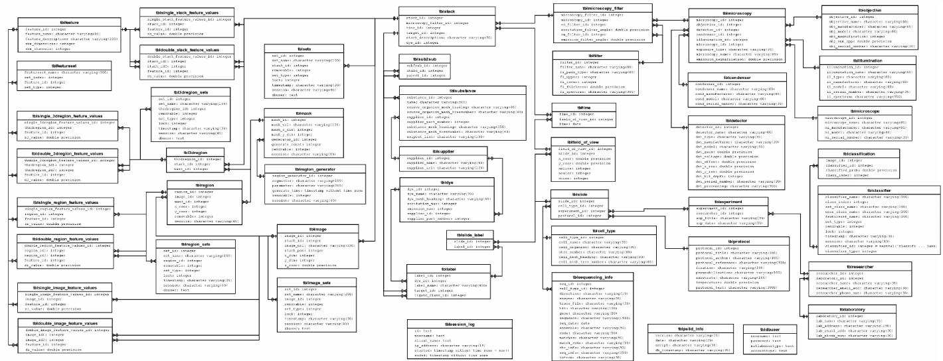
Op Sys are Complex!
Designed for operational performance.
Hopefully 3rd normal form, but …
Often multiple ways to join tables.
Columns not used as intended, overloaded, or their use changes over time as needs evolve.
Customer focused columns, if any, seldom QA’d!

Slide 11

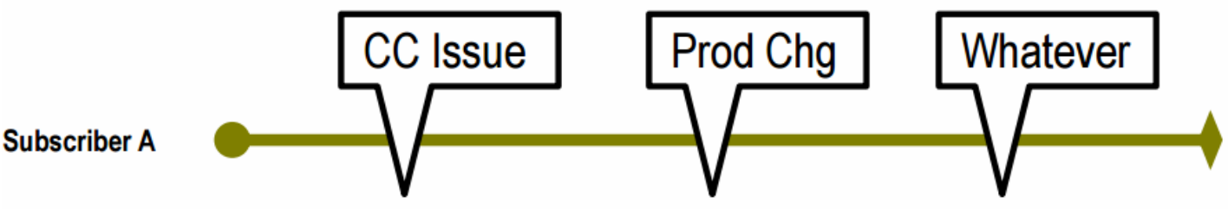
Op Sys are Noisy!
Many op sys events are irrelevant from the customer insights perspective.
Example: Subscription processing needs to deal with the real world and handle payment exceptions which don’t reflect customer decisions.
The subscriber decides to start and, possibly, stop:
But the subscription op sys reports:

Slide 12
Data Flavors - Review
Operational Systems
Direct Responses
Everything else is pretty straightforward – often single files.
Order Processing
Fulfillment
Web site(s)
Call Centers (CRMs)
Email system(s)
Front line employee “systems”
Stated preferences
Search requests
Mindful clicks
Surveys: NPS, satisfaction, …
Social Comments
Customer ID!
Data Appends
Analytic Results
Neighborhood demographics
US Census @ ZIP5 or Census Block Group level
PRIZM, etc
Individual match-backs: Acxiom
Pooled industry data
From our data science team:
Segments
Scores
Recommendations
Updated in “real time” – relative to customer’s timescale.

Slide 13
Data Related Roles
Data Engineers
Business Analysts
Data Scientists
The data geeks responsible for knowing & maintaining the data generated by your organization.
Typically in IT, data services, or finance
Power SQL gurus; some data architecture skills
Big data platform skills.
Data schlepping & ETL
Engineering mindset: QA/QC, git, agile, and (hopefully) documentation
Have overflowing work queue!
Mission critical stuff
Ad Hoc from business
The front line business folks tasked with understanding your customers and, maybe, communicating with them.
Embedded in departments
Results focused
Time pressure
Domain experts
Probably not titled “analyst”
Excel & PowerPoint
Data exploration/reporting: Tableau, QlikView, etc
Maybe lite SQL, R, ?
Constantly bug data engineers!
Responsible for deep insights, propensity models, segmentation, and next best action scores.
Should be close to business users & have strong domain knowledge.
Strategic & Tactical roles
Machine Learning skills in R, Python, or?
Understand statistics & probability.
May do their own data prep - if they do, ~ 80% of effort
Predict() results may be operationalized.
Scarce resource!

Slide 14
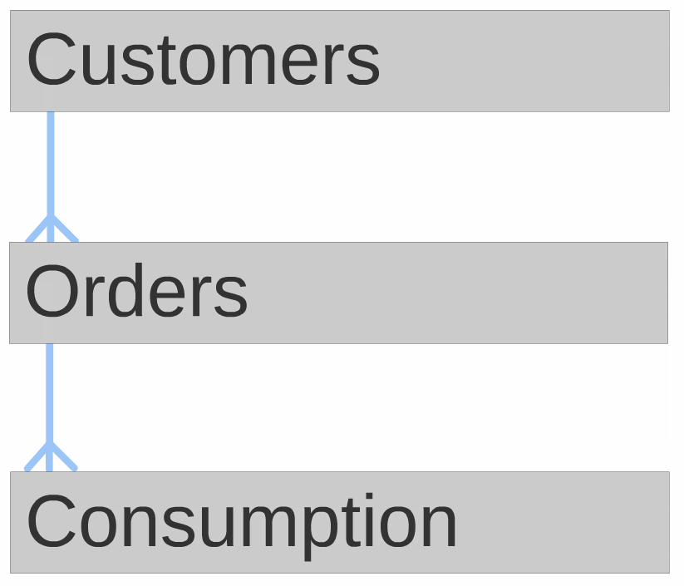
A Data Structure for Customer Insights
Basic design principles:
Be analyst ready.
Front end tool agnostic.
Model customer decisions.
Really simple structure. Three levels of abstraction:

Slide 15
1. Be Analyst Ready
“Ready” in this context means the user must be really comfortable with this data source. Goals:
Easy – technically & conceptually
Self documenting
Complete
Accurate
Timely
Fast
Evolving

Slide 16
2. Front-end Tool Agnostic
If this data design is to serve a wide range of data consumers, ranging from junior business analysts to grey haired data scientists, it must be totally tool agnostic. Implementation must support:
Native SQL access
JDBC preferred; ODBC if needed.
Optimized drivers for top tools like Tableau, …
Decent Excel performance.
Jim’s last product platform was on PostgreSQL, last subscription platform on AWS Redshift.

Slide 17
3. Model Customer Decisions
Focus on CIA’s
Customer Initiated Actions - and not site or application generated events which just add noise.
Think like a customer when designing your model!
Don’t get distracted by all your cool technology, tools, and marketing theories!

Slide 18
4. Three Levels of Abstraction
Each level represents “all there is to know” about the level – an evolving goal, not initial deliverable!
The general terms are:
Customers
Orders
Consumption
Rename appropriately for your business.

Slide 19
Levels of Abstraction – Two Flavors
Subscription Business (SB)
Product Business (PB)
Subscriber
Subscription
Usage: watch, visit, apply, read, …
Customer
Order
Order detail: including all SKU details merchants need to track.
Remember each level is to have “everything there is to know” about the level. So if our business question is about subscribers, we should only need to look at the subscriber table.

Slide 20
SB: 1. Subscriber Summary
“Everything” about a subscriber.
PK: Subscriber ID
First Name (only, rest of PII restricted)
Is Currently Subscribed flag
Initial & Last Subscription dates & products
Recency: Last Subscription Chain End Date, Last Usage Stint
Frequency & Counts: # Chains, # Payments, # Products, # Usage Stints
Monetary: RTD, RTD 1st Chain, RTD <initial x months>
Tenure: # Days, # Days Subscribed, % Coverage
Acquisition Details: Channel, Offer, …
Consumption Profiles: Initial, Latest, Breadth
General Engagement: site, email, call center, …
Demographics: Neighborhood & Individual Append
Cohort Flags: YYYY, YYQQ, YYMM
Segments & Scores from data science
Any alternate Subscriber identifiers (FKs to other systems)
More ????

Slide 21
SB: 2. Chained Subscription Summary
“Everything” about a subscription chain.
A subscription chain models the CIA to start a subscription and, optionally, stop or change the subscription.
PK: Subscriber ID, Chain Sequence #
Is Subscription Active flag
Products: This chain, prior chain, next chain
Dates: Starting & Ending
Intervals: Days to prior chain. Days to next chain.
Payments: # and $s
Initial Conditions: status, promo, offer, …
Cancel: Requested On, Is Voluntary, Stated Reason
Consumption within chain: level, type, breadth, acceleration
More??

Slide 22
SB: 3. Usage Stint Summary
“Everything” about a usage stint.
A usage stint models the CIA to start continuous consumption and then to stop. For fitness club: entering & leaving. For on-line training: start watching & stop watching for more than 30 minutes.
PK: Subscriber ID, Stint Sequence #. (AK: Chain Sequence #)
Timestamps: Start & End
Usage Profile:
What used – perhaps multiple factors describing content
How many used
Where used – location, platform
More ???

Slide 23
PB: 1. Customer Summary
“Everything” about an order.
PK: Customer ID
First Name (only, rest of PII restricted)
Status Flags: Is Registered, Has Purchased, Is <special>, …
Initial & Last Order Dates, Amounts, & Top Product Focus
Following are perhaps also split out by product group:
Recency: Days since last order
Frequency & Counts: # Orders, # Product Groups, # SKUs
Values: RTD, RTD<initial x months>, Average Order Value
Interval: Tenure Days (days since first order)
Order Rates: Orders per [year, quarter, month], frequency variance
Seasonal & Life-stage purchase RFM’s
Acquisition Details: Initial Channel, Offer, Initial Product Group, …
General Engagement: site, email, call center, …
Demographics: Neighborhood & Individual Append
Cohort Flags: YYYY, YYQQ, YYMM
Segments & Scores from data science
Any alternate Subscriber identifiers (FKs to other systems)
More ????

Slide 24
PB: 2. Order Summary
“Everything” about an order.
PK: Order ID; FK: Customer ID
Order Sequence # (for individual customer)
Order Date / Time
Is Most Recent Order flag
# Line Items
Intervals: Days to Prior Order, Next Order
Payments: Total. Perhaps break down: merchandise, shipping, tax, …
Discounts & Offer codes
Returns & Refunds
Source: Channel, Referral, …
Top Product Group. % Dominance of Top Group.
Geo location: Billing & Shipping
Follow-up Satifaction
More???

Slide 25
PB: 3. Order Line Detail
“Everything” about an order line.
PK: Order ID, Line #. FK: Customer ID
SKU, Description
Quantity
SKU specific offer, discount
Product kind, group, class, … (function of product taxonomy)
Price(s):
Standard
Actual
Breakdown by components & options
Primary Attributes: Size, Color, ….
Attributes of Options: (Function of option)
This can be very complex for SKU’s with many options. Merchants will want to slice & dice along option categories.

Slide 26
The Structure in Action
This customer insights focused data structure has two major benefits:
Business analysts can easily get consistent data driven answers to most of their customer related questions – by themselves!
Data scientists have a clean, rich data set for modeling that will sync up with business results.
Following business examples will use SQL. The same logic applies to using a visual tool like Tableau.

Slide 27
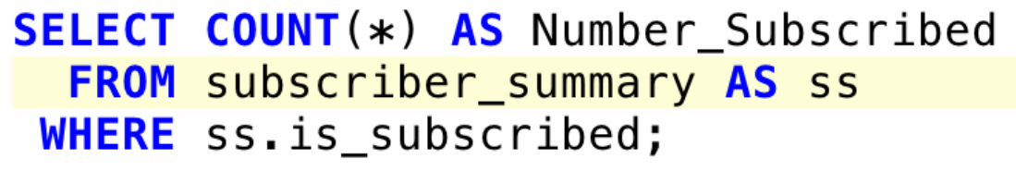
Ex 1: How many subscribers do we have?
SQL
Question is about subscribers. So we use the 1st level of abstraction – Subscriber Summary table. SQL is trivial! Just count the number of subscribers who have Is Subscribed = TRUE.
This works because the complex business rules defining if someone is subscribed are built into the Is Subscribed flag.
The process of building the Subscriber Summary table is non-trivial to ensure it is “analyst friendly!”

Slide 28
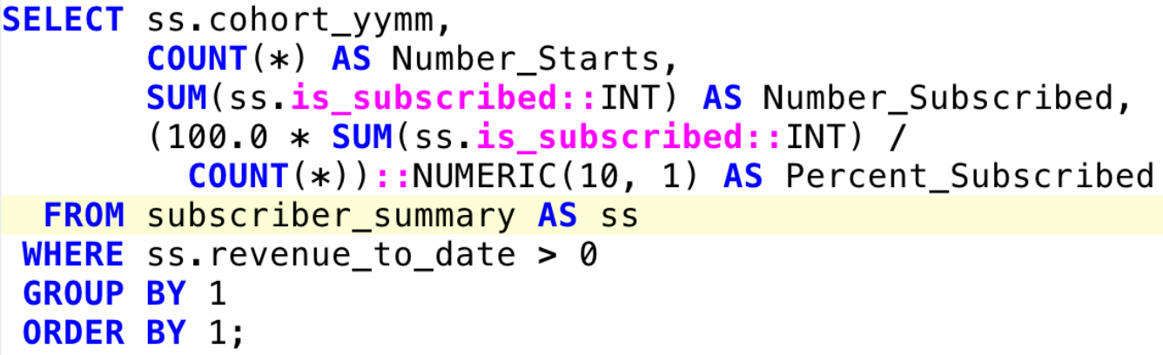
Ex 2: By monthly cohort, how many, and what % of, paying subscribers are currently subscribed?
SQL
Question is also about subscribers. Use the Subscriber Summary table again.
“paying subscribers” have a RTD > $0. “monthly cohort” held in the Cohort YYMM column. Use in GROUP BY. COUNT(*) gives # subscribers who have paid, ever. SUM(…) gives the # who are currently subscribed.

Slide 29
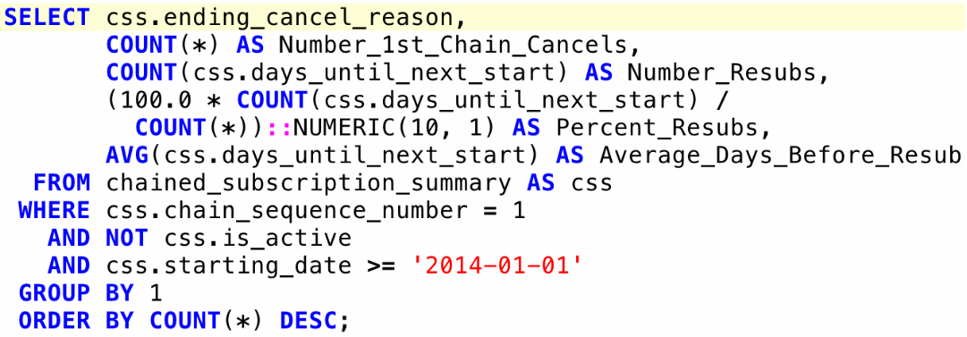
Ex 3: By cancel reason, what % of 1st chain cancels re-subscribe and what is average lag (2014 onward)?
SQL
Question is about subscriptions – 2nd level. Use Subscription Summary.
“1st chain cancels” – Chain Sequence # = 1 & Is Active is not TRUE. “2014” onward – Starting Date from Jan 1, 2014 to date. “By cancel reason” – GROUP BY Ending Cancel Reason for chain. Days Until Next Start will be NULL if no 2nd chain.

Slide 30
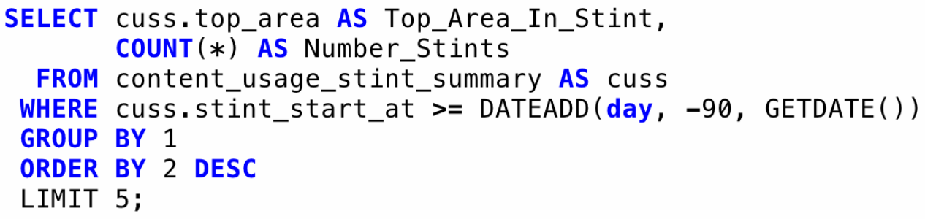
Ex 4: What are the top five content areas viewed over the last 90 days?
SQL
Question is about usage – 3rd level. Use Content Usage Stint Summary.
“last 90 days” – usage stint starts after 90 days ago via GETDATE() “top content areas” – stint’s Top Area – the GROUP BY but ORDER BY the # stints for the content area in descending order, and LIMIT to just top 5

Slide 31
Key Takeaways
“The (data) structure stupid!”
Focus on CIA’s (Customer Initiated Actions)
Be analyst ready.
You are a (data) publisher! Act like one.
Start simple, then expand what “everything” means as you roll out to the business.
Make the investment in structured data. It will pay off!

Slide 32

Wrap Up
See Jim’s archive at DS4CI.org for
These slides.
The related White Paper.
And much more!
Contact me at: Jim@DS4CI.org
Appendix follows with
Real world subscription example
Sessionization in SQL & R
Questions?
Comments?
Now is the time!

Slide 33
Appendix
1. Real-world subscription business example.
2. Sessionization in SQL and R

Slide 34
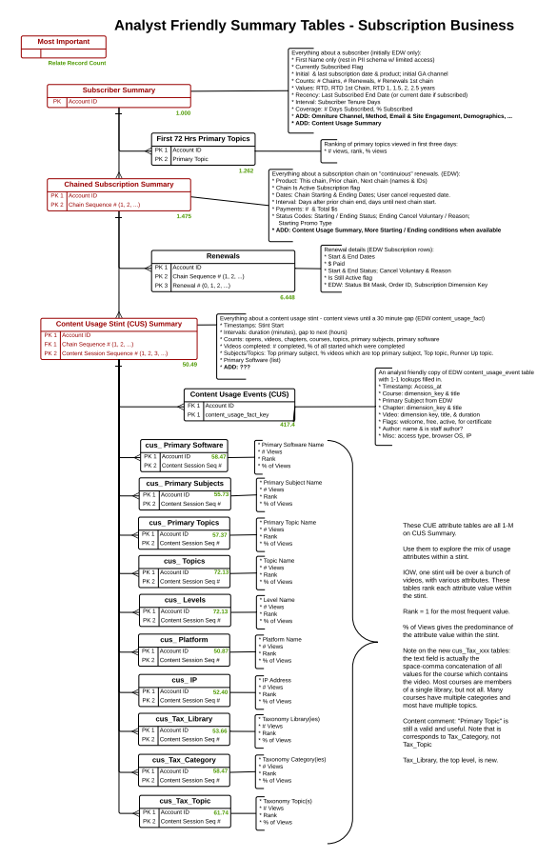
Real-world Subscription Model
Red Tables are the three levels of abstraction.
Green #’s show relative number of records to Subscriber Summary
Here we just show keys and description of contents.

Slide 35
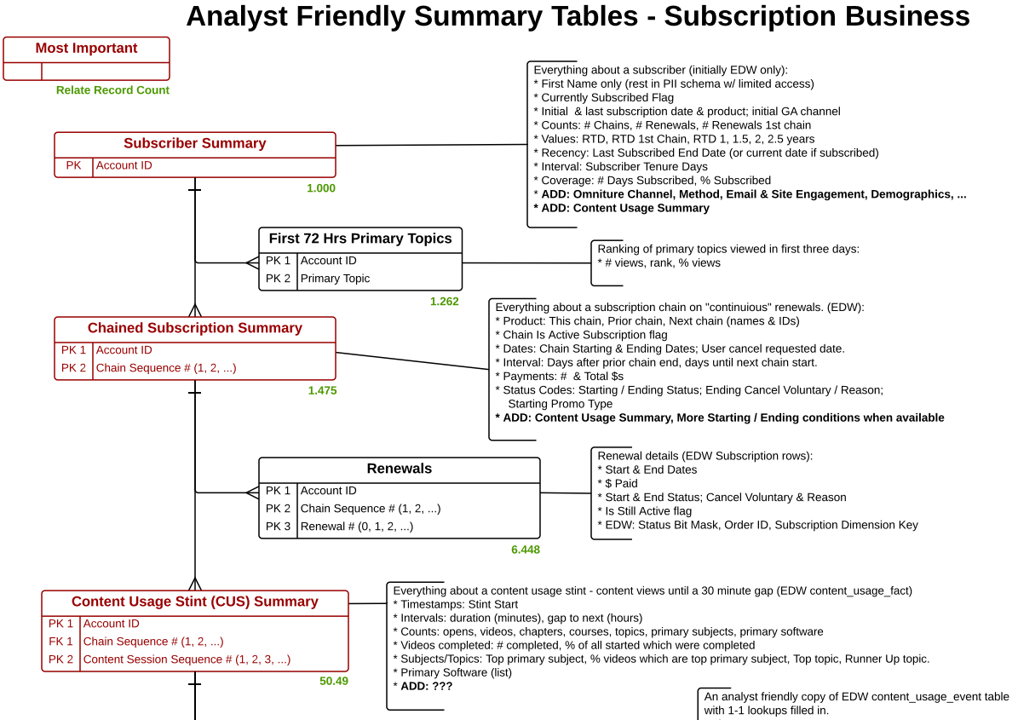
Real-world Subscription Model - Top

Slide 36
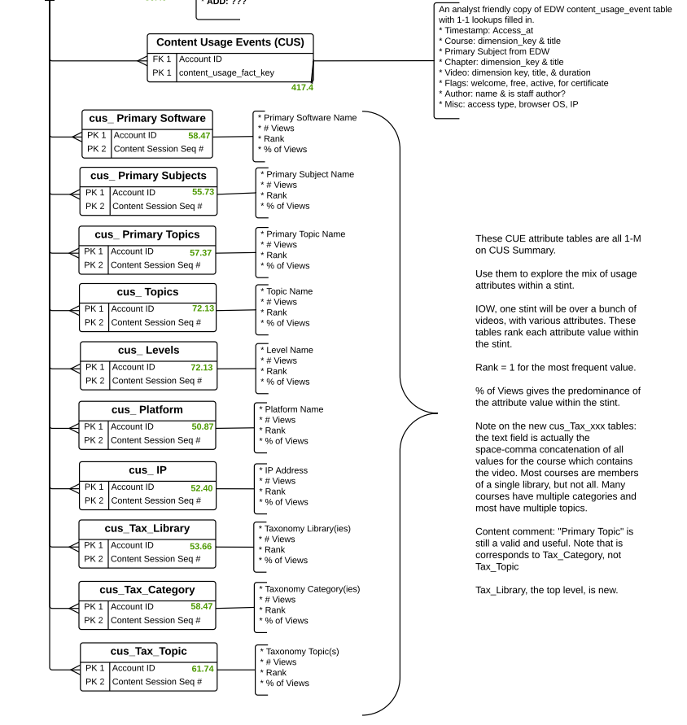
Real-world Subscription Model - Bottom
Content Usage Events is an analyst friendly version of the video view event fact table w/ all dimension joins done.
The cus_xxx table rows have counts and % of total for each value in CUS dimensions within a Content Usage Stint
These fill the Top_xxx and Pct_xxx values in the Content Usage Stint Summary.
To take a deep dive within the stint look at the cus_xxx tables.

Slide 37
Sessionization Methods
Content Usage Stint Summary and Chained Subscription Summary tables are rollups of event level data. These are special cases of the general event sessionization problem, which can be done in any modern SQL platform or in R (with dplyr package).
The next slides will cover the highlights in both languages.
For background and details see Jim’s archives at:
For SQL see Sessionization Methods – Getting Past Big Data Noise
Especially slides 14-17 onwards and 26-28
For R see dplyr Example 2 – Sessionize Web Events

Slide 38
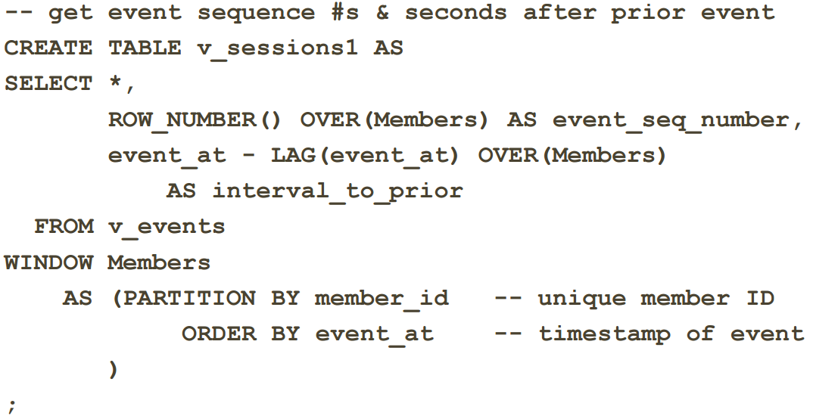
Sessionization in PostgreSQL (1 of 3)
Problem: Sessionize web events by member ID using the 30 minute end-of-session rule.

Slide 39
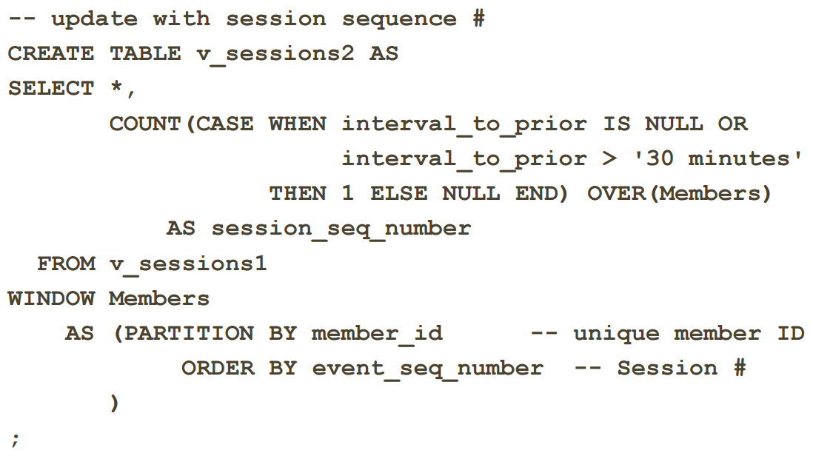
Sessionization in PostgreSQL (2 of 3)

Slide 40
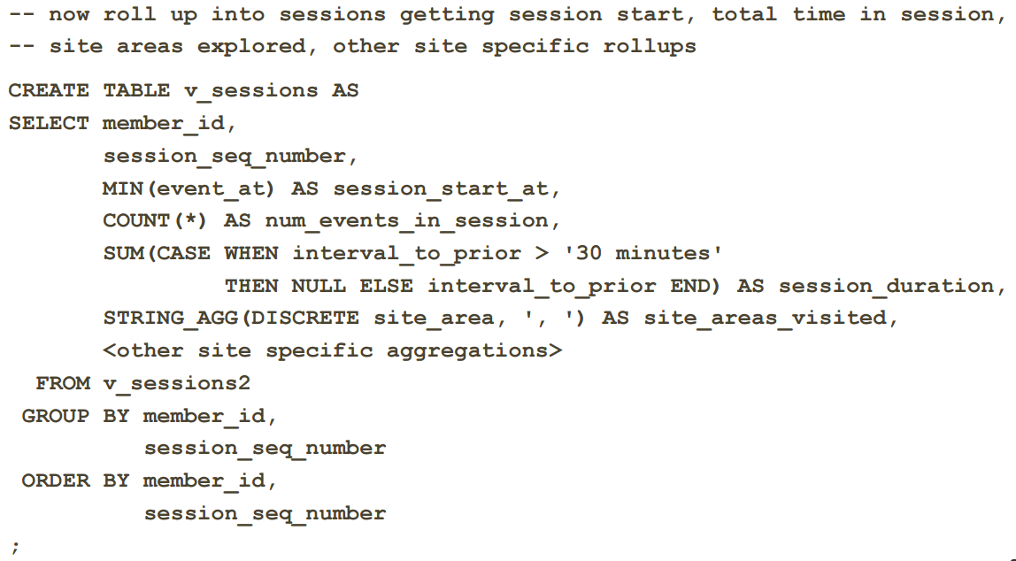
Sessionization in PostgreSQL (3 of 3)

Slide 41
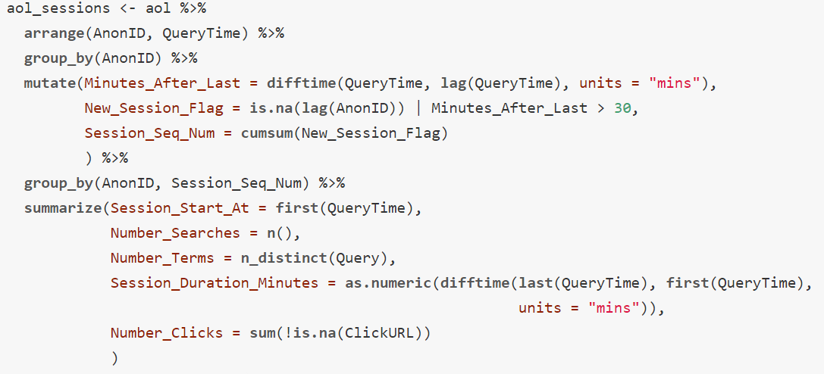
Sessionization in R w/ dplyr
Problem: Sessionize AOL search events by ID using the 30 minute end-of-session rule.
For full details see dplyr Example 2 - Sessionize Web Events

